Slide 1
Implementation of Basic Logic Gates in real world application

Slide 2
Logic Gates
A logic gate is a device that serves as a foundation for digital circuits. They carry out essential logical operations in digital circuitry.
Most electrical gadgets we use today have logic gates of some kind. Logic gates, for example, may be found in technology such as smartphones, tablets, and memory devices.
Logic gates in a circuit make judgments depending on a mix of digital signals from their inputs. The majority of logic gates have two inputs and one output.
Boolean algebra is the foundation of logic gates. Every terminal is in one of two binary states at any one time: false or true.
True represents 1 and falsely represents 0.

Slide 3
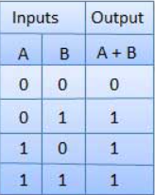

Door Bell using OR Gate
The Logic OR Gate is a sort of digital logic circuit that has an output that is HIGH to a logic level 1 only when one or more of its inputs are HIGH
When someone presses either the front door switch or the back door switch, the doorbell must ring.

Slide 4
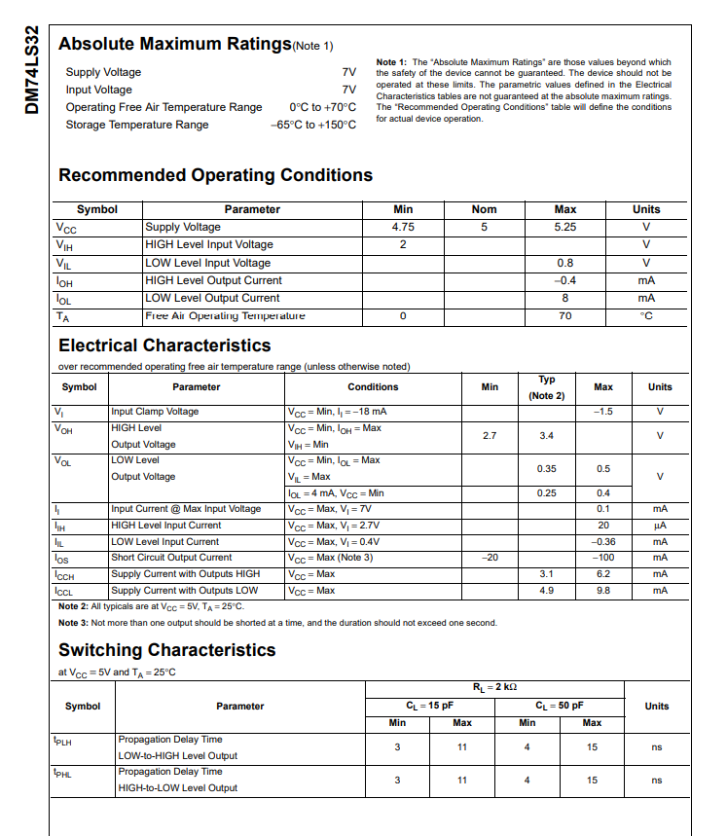
Datasheet of 7432 IC (OR GATE)

Slide 5
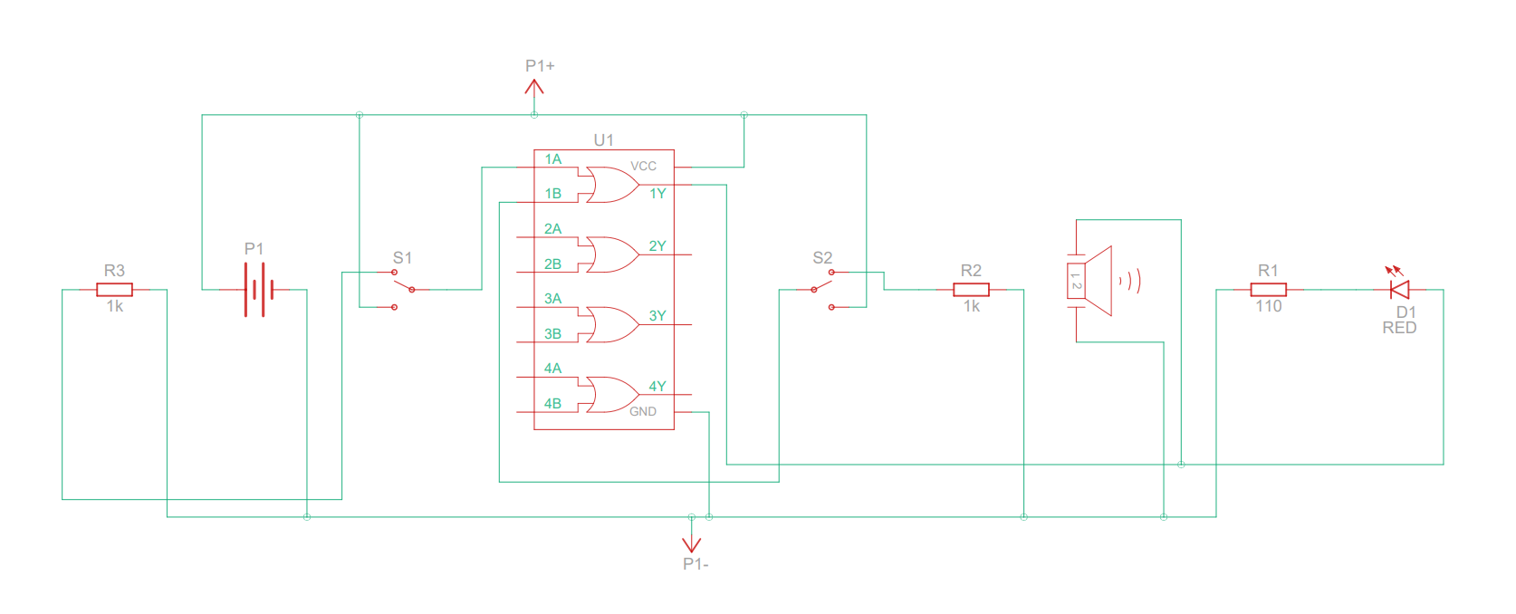
Circuit Diagram of DOORBELL

Slide 6
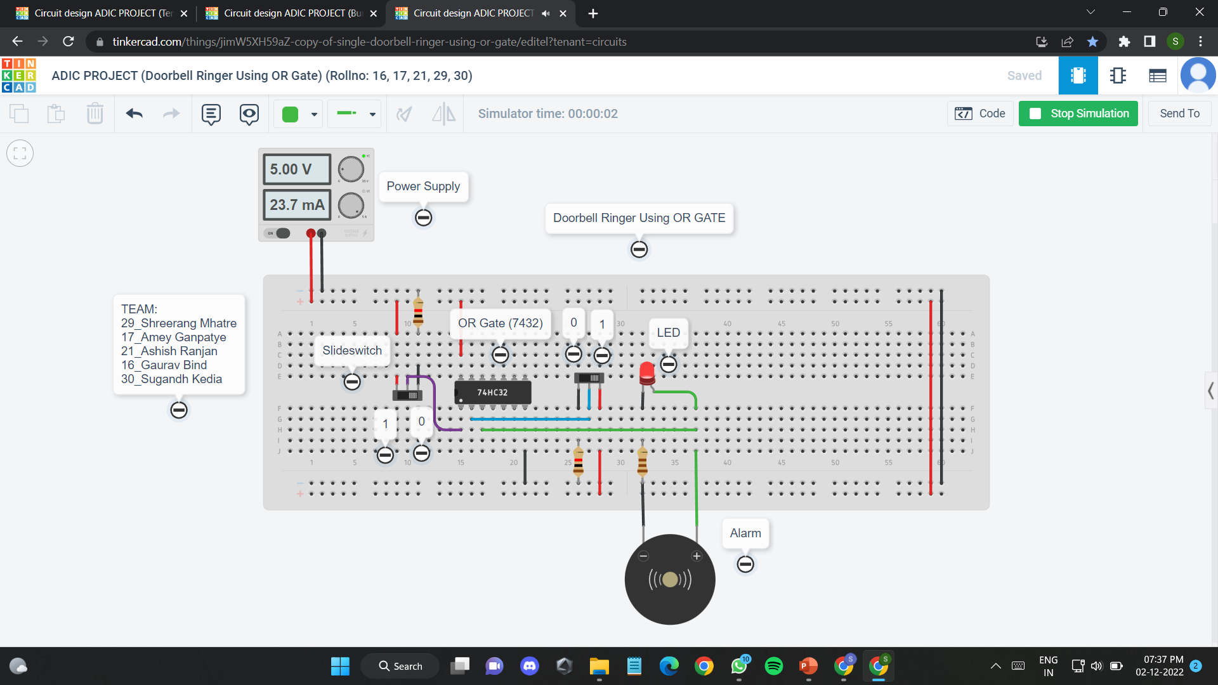
Simulation OF dOORBELL on TINKERCAD

Slide 7
Thankyou!!

